Slide 1
Independent Project-1 Presentation
Mentor – Prof. Bakul Gohel Aditya Shah - 202003045

Slide 2
ANN (Artificial Neural Networks)

Slide 3
Artificial Neural Networks (ANNs) are computing systems inspired by the human brain. They consist of interconnected nodes organized in layers. Information flows through these layers, with each node processing data and passing it to the next layer. ANNs learn by adjusting connections between nodes to minimize errors, a process often driven by optimization algorithms like gradient descent. They're powerful tools in machine learning, used in diverse fields for tasks like image recognition, language processing, and more.
In neural networks, a neuron is a fundamental computational unit that receives input, processes it, and produces an output. Inspired by the biological neurons in the human brain, an artificial neuron, also known as a node or a perceptron, performs simple computations on incoming data.

Slide 4
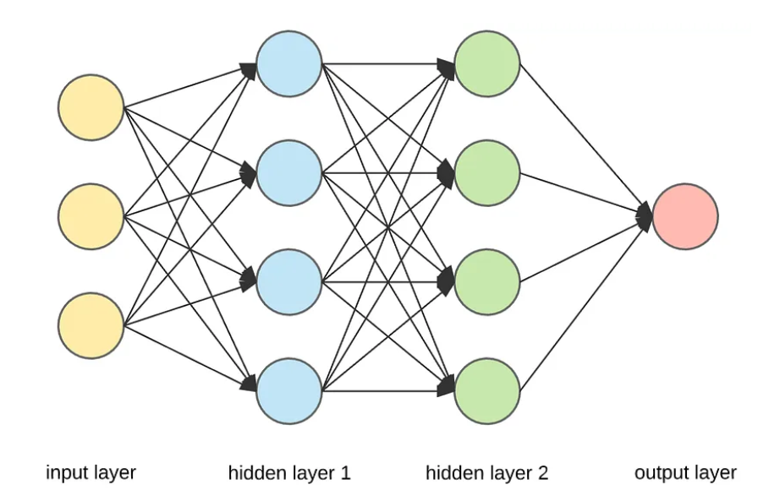
In the diagram, ANN has three types of layers, Input layer, hidden layers and output layer.
In the input layers one can think of a neuron as an input parameter, whereas output layer will have only one neuron which will hold the probability of possible outcome. Whereas hidden layers are responsible for holding the patterns in them.

Slide 5
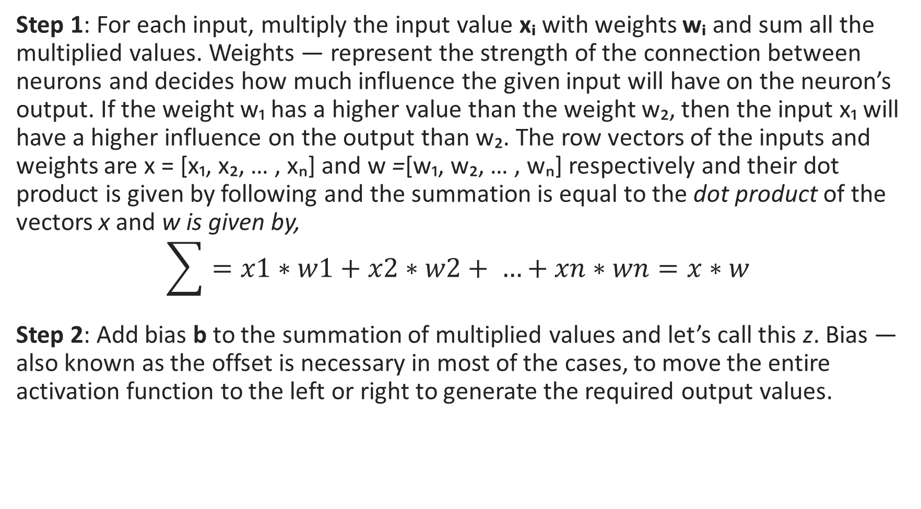
Forward Propagation

Slide 6
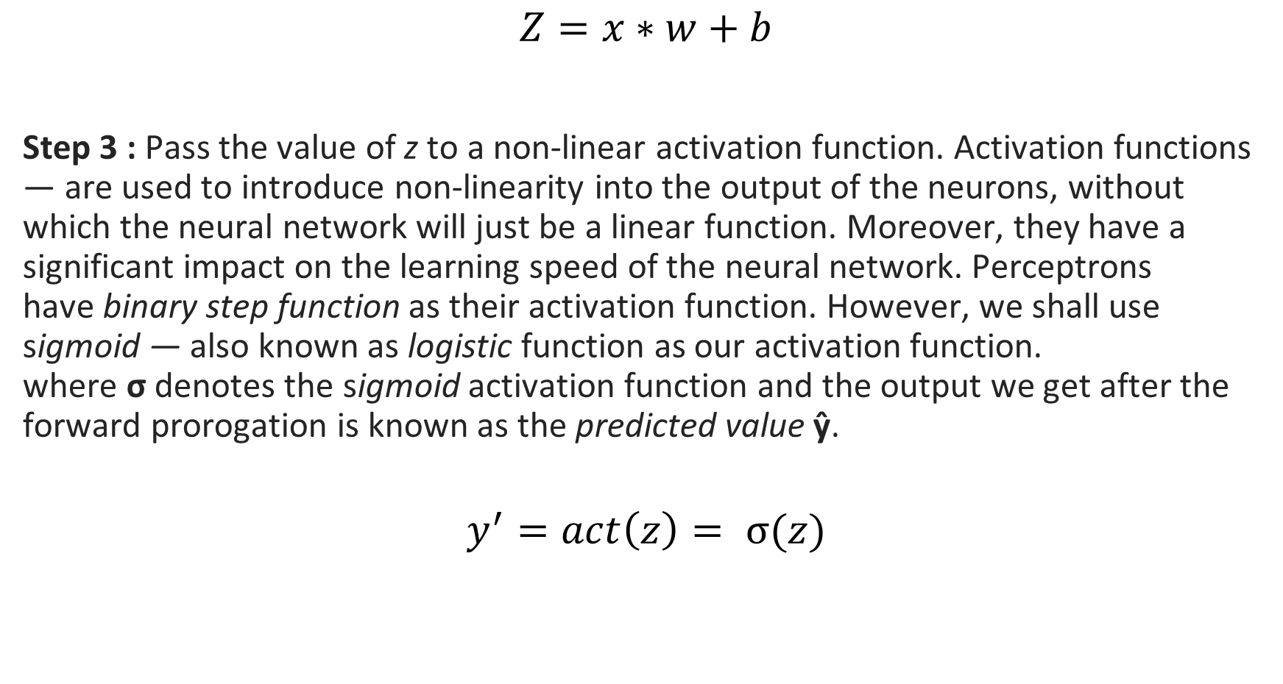

Slide 7
Backward Propogation
Backpropagation, short for backward propagation of errors, refers to the algorithm for computing the gradient of the loss function with respect to the Iights. However, the term is often used to refer to the entire learning algorithm. The backpropagation carried out in a perceptron is explained in the following two steps.
Step 1: To know an estimation of how far are I from our desired solution a loss function is used. Generally, mean squared error is chosen as the loss function for regression problems and cross entropy for classification problems. Let’s take a regression problem and its loss function be mean squared error, which squares the difference between actual (yᵢ) and predicted value ( ŷᵢ ).

Slide 8
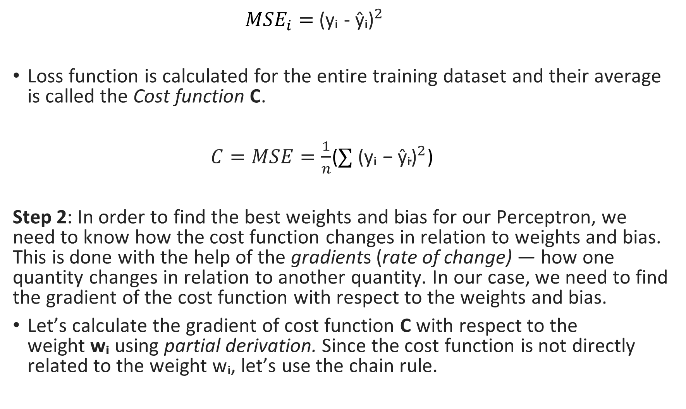

Slide 9
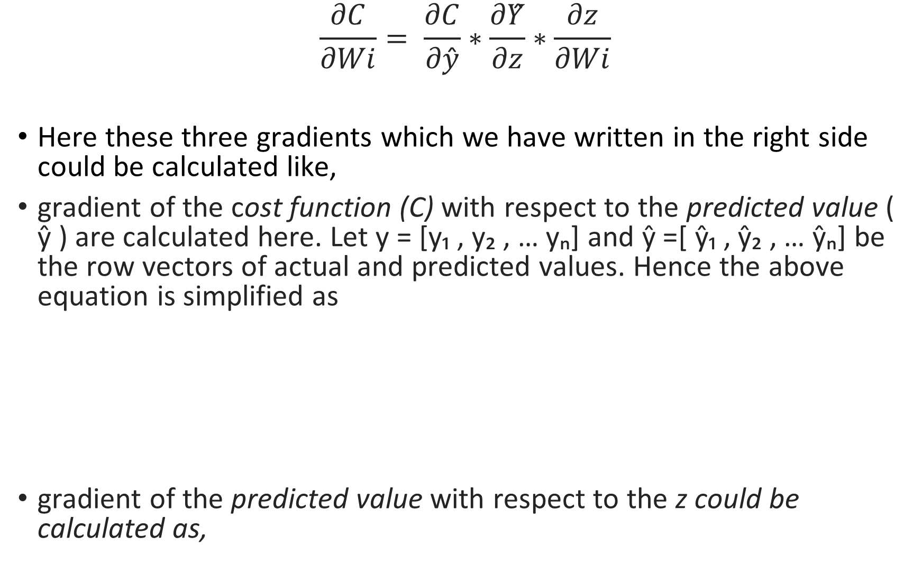
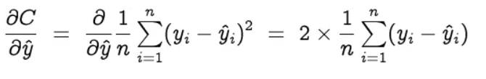


Slide 10
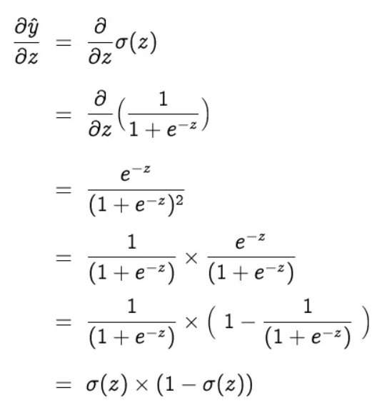
And now the gradient of z with respect to the Iight wᵢ is,

Slide 11
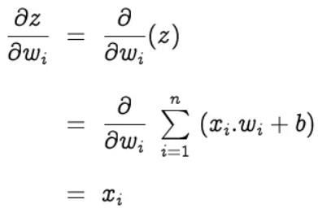

Finally,

Slide 12
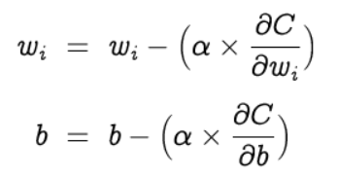
Now by getting these values I can update the weights and bias to get better results, gradient descent is repeated until convergence.

Slide 13
So summarizing the steps I use in training the datasets are,
Step 1 : Initialize weights randomly
Step 2 : Predict the output by calculating the activation function of the weighted sum for each input.
Step 3 : Calculate the error in our output by the cost function
Step 4 : Use back propagation to change the values of weights and biases.
Step 5 : to first 4 steps recursively.

Slide 14
Convolutional Neural Network(CNN)

Slide 15



Convolutional Operation
Cross Correlation operation:
Convolution Operation:
Input
1 | 0 | -1
2 | 3 | 2
0 | 1 | -1
Kernel
Output
2 | 0
1 | -1
1 | 1
3 | 8
*
Rotate Kernel by 180
1 | 0 | -1
2 | 3 | 2
0 | 1 | -1
-1 | 1
0 | 2
7 | 3
3 | -3
*
*
- Cross-correlation operator

Slide 16
Padding
Why Padding ?
Types of Padding: Valid Padding and Same Padding
0 | 0 | 0 | 0 | 0 | 0
0 | 2 | 3 | 3 | 2 | 0
0 | 3 | 3 | 3 | 3 | 0
0 | 3 | 3 | 3 | 3 | 0
0 | 2 | 3 | 3 | 2 | 0
0 | 0 | 0 | 0 | 0 | 0
1 | 2 | 2 | 1
2 | 3 | 3 | 2
2 | 3 | 3 | 2
1 | 2 | 2 | 1
Add Padding
Number of times cell get chance in cross-correlation calculation
Kernal Matrix of size 2 x 2

Slide 17
Stride
It is related to moving of kernel Matrix over the input matrix.
Change of stride value results in change of shape of output matrix.
1
2
1
2
Stride(1,1)
Stride(2,2)

Slide 18
Pooling
Max pooling
Pool maximum from filter(3)
Average pooling
Take Average of all values in filter
1 | 2 | 2 | 1
2 | 3 | 4 | 2
2 | 3 | 1 | 2
1 | 2 | 2 | 1
1 | 2 | 2 | 1
2 | 3 | 4 | 2
2 | 3 | 1 | 2
1 | 2 | 2 | 1
Filter size : 2 x 2
Stride : (2,2)
Filter size : 2 x 2
Stride : (2,2)
3 | 4
3 | 2
2 | 2.25
2 | 1.5

Slide 19
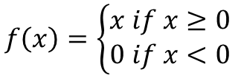
Convolutional Layer
Input Image
ReLU(
Output Image 1
+ b)
Output Image 2
Convolution
Pooling
Activation function
Bias

Slide 20
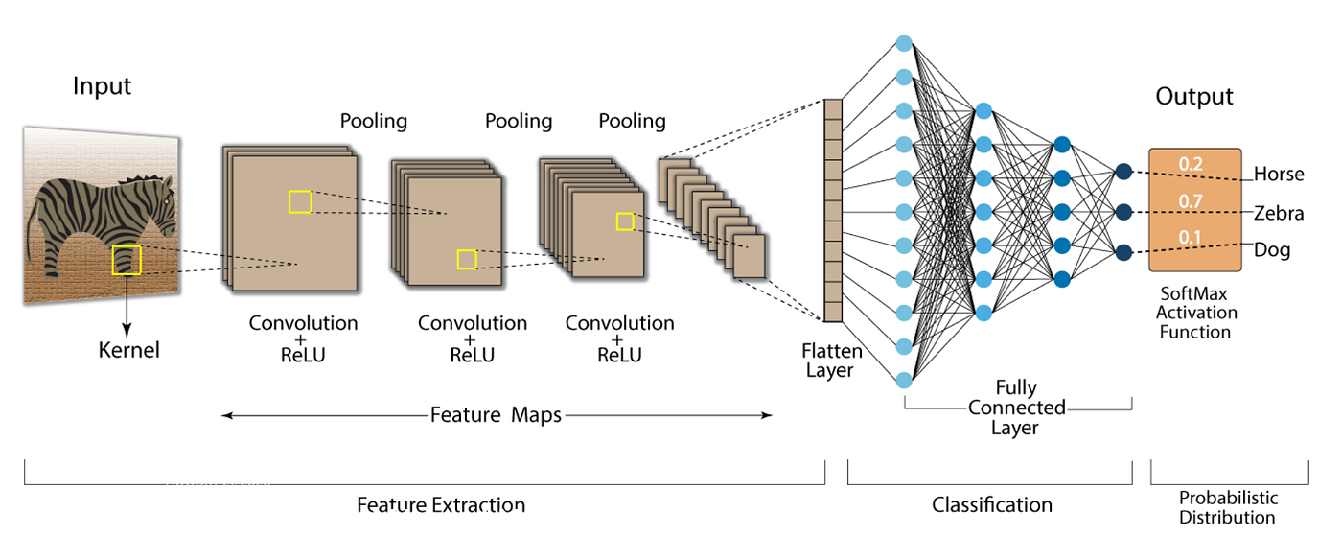
CNN Architecture
Convolutional
Layer 1
Convolutional
Layer 2
Convolutional
Layer 3
Reference : https://nafizshahriar.medium.com/what-is-convolutional-neural-network-cnn-deep-learning-b3921bdd82d5

Slide 21
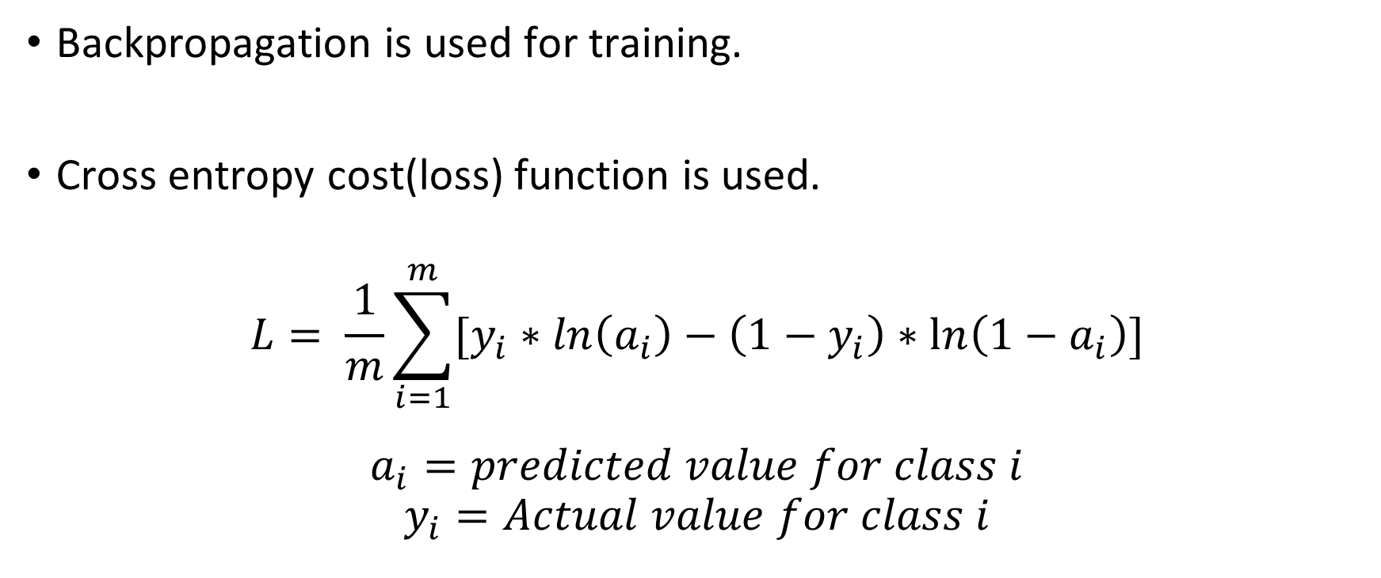
Training of CNN

Slide 22

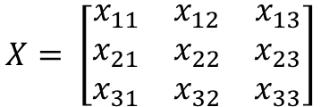

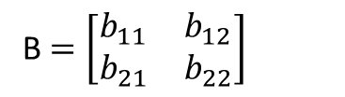
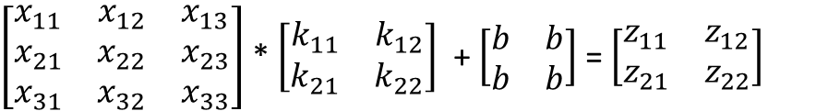
Forward Propagation
X
Input from Previous Layer
Convolution
Z
Forward propagation :
Let,
K,b
Hence,

Slide 23





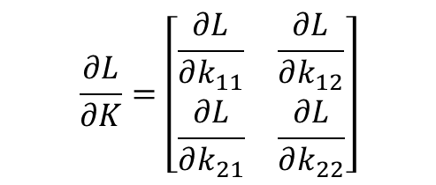
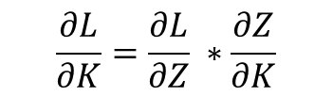
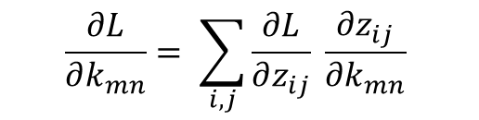
Backpropagation
Input from Previous Layer
X
Convolution
Z
K,b

Slide 24
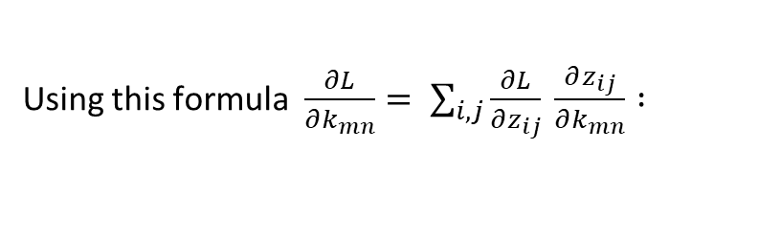
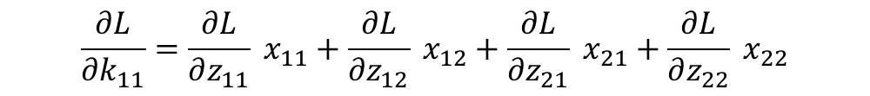
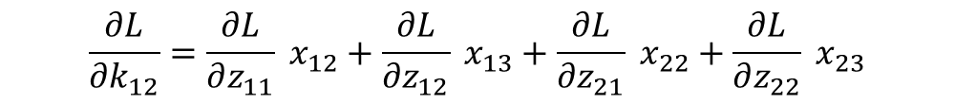

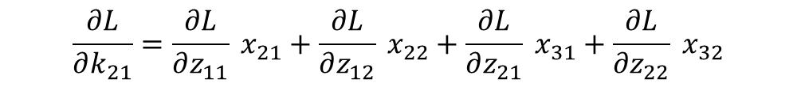
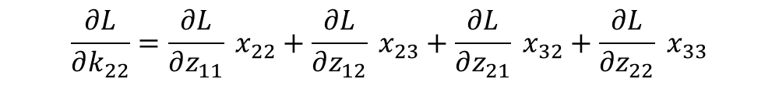
Backpropagation

Slide 25
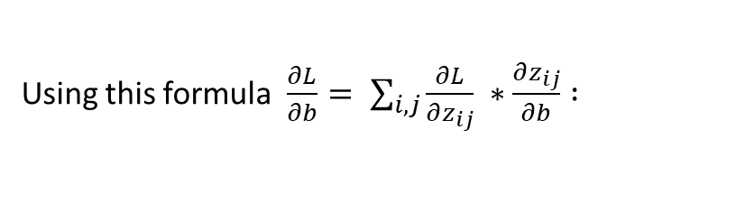

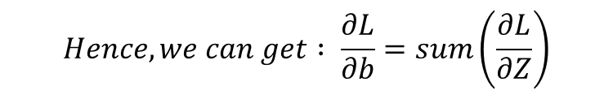
Backpropagation

Slide 26
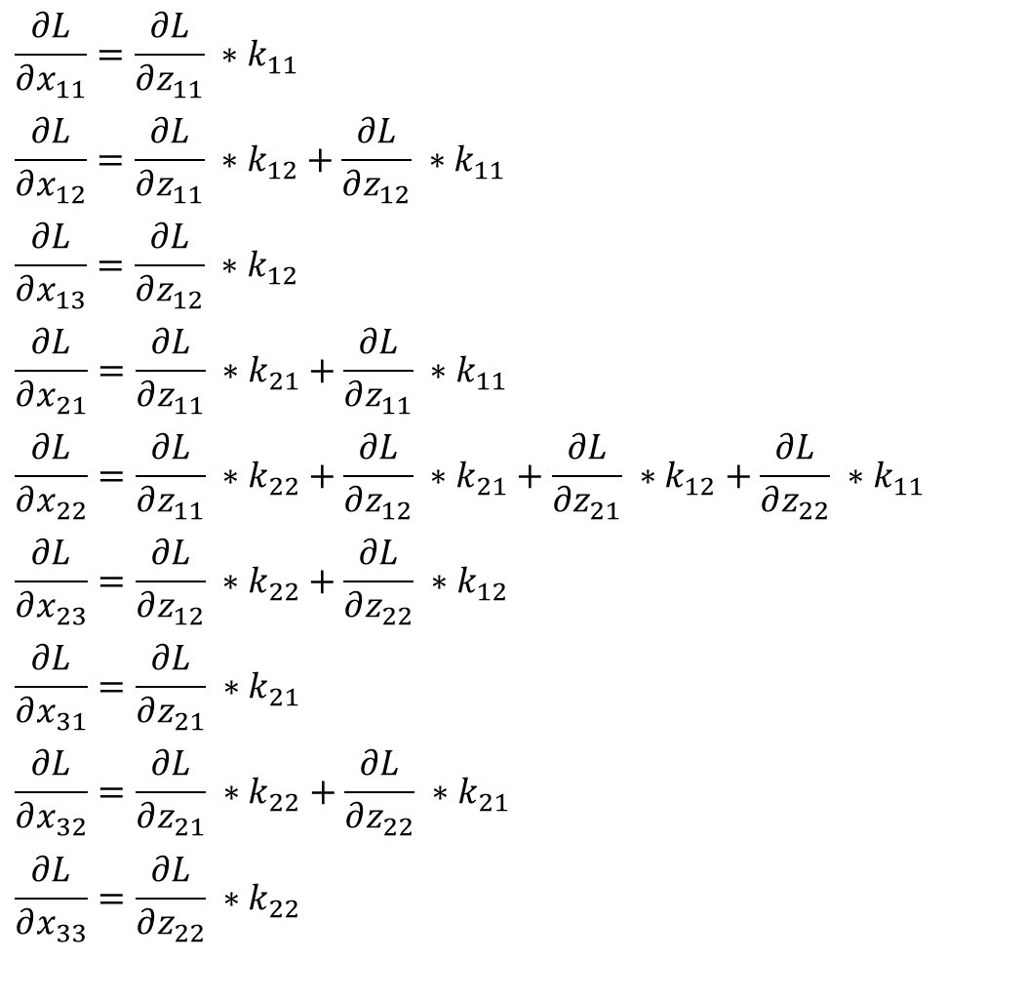
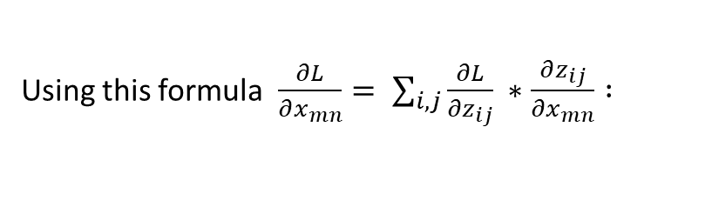
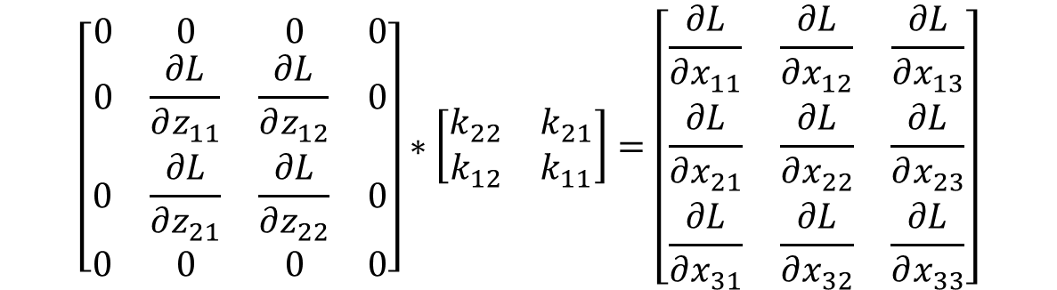

Backpropagation
180 degree rotated Kernel Matrix

Slide 27
Backpropagation and Direct feedback alignment

Slide 28
Training of Neural Networks
Backpropagation is a powerful approach to train Neural Networks
Backpropagation could not be biologically implemented by the human brain.
It requires synaptic symmetry in the forward and backward paths. This is known as the weight transport problem.
To overcome this problem, I need biologically plausible algorithms that is feedback alignment algorithms.

Slide 29
Problems with Backpropagation
There are two major problems with the backpropagation algorithm:
Backpropagation is a sequential process: It is necessary to compute the gradient of the last layer before computing the gradient for the current layer(recursive process). For neural networks, which have a high number of layers it becomes a very time-consuming process to train Neural Network.
The gradient computation: While computing the gradient, I need to calculate the transpose of the Iight matrix that causes a time complexity of O(m*n), where m and n are the dimensions of the Iight matrix.

Slide 30
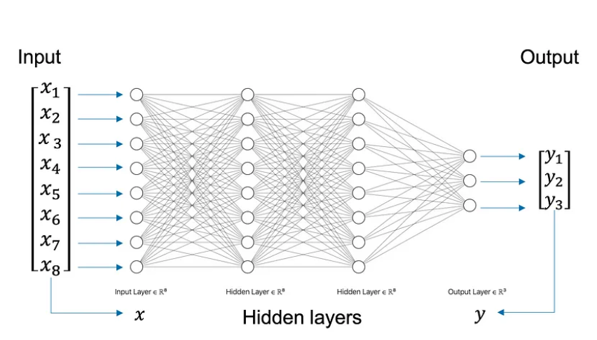
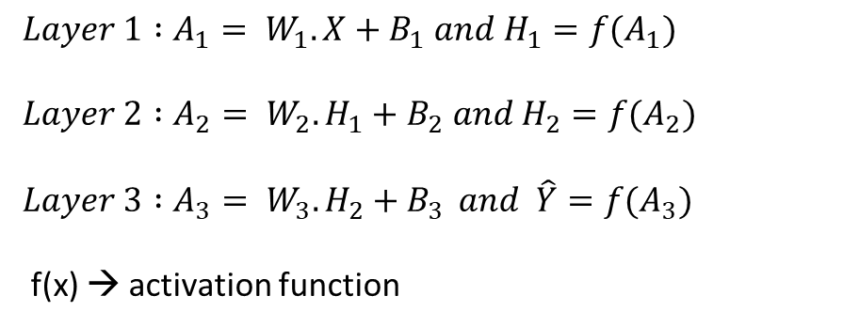
Backpropagation and DFA
Let following ANN with three Neural Networks:
Forward Pass:

Slide 31
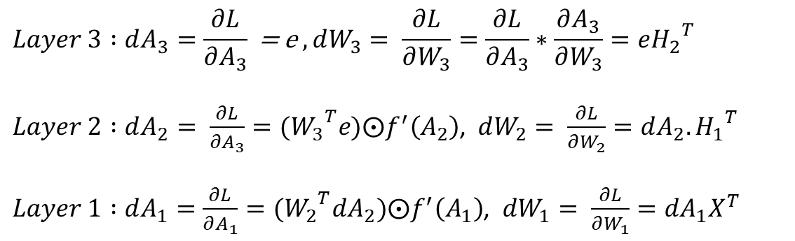
Backpropagation and DFA
Let following ANN with three Neural Networks:
Backpropagation:
Quantities depend upon the next layer.
DFA algorithm replaced it with different quantities.

Slide 32


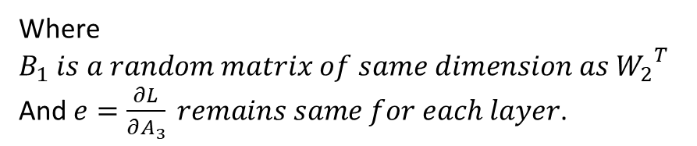
Direct Feedback Alignment
Replace the gradient of the loss w.r.t. to the next layer's activation to the error of all layers.
Replace the weight transposition of the next layer with the random matrix of the appropriate size.
This formation of the gradients allows us to train neural networks in parallel computation.
Updates in layer results in BP to DFA

Slide 33
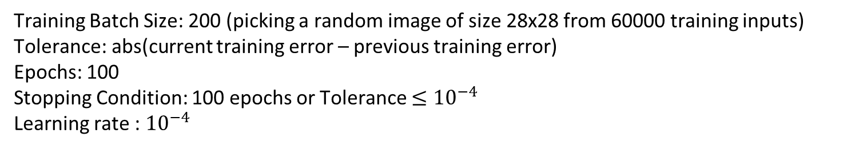
Results
These are the results of the ANN model with different configurations over the MNIST dataset :
ANN Model | BP | DFA
1 x 400 tanh | Training Error : 5.67% Test Error : 8.12% | Training Error: 6.09% Test Error: 7.76%
1X800 tanh | Training Error: 2.66% Test Error: 7.93% | Training Error : 5.13% Test Error : 7.35%
2X400 tanh | Training Error: 1.57% Test Error: 14.79% | Training Error: 5.49% Test Error: 8.89%
2x800 tanh | Training Error: 0.74% Test Error: 15.40% | Training Error : 4.35% Test Error : 8.00%

Slide 34
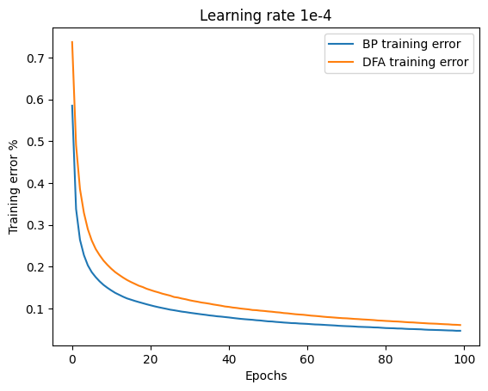
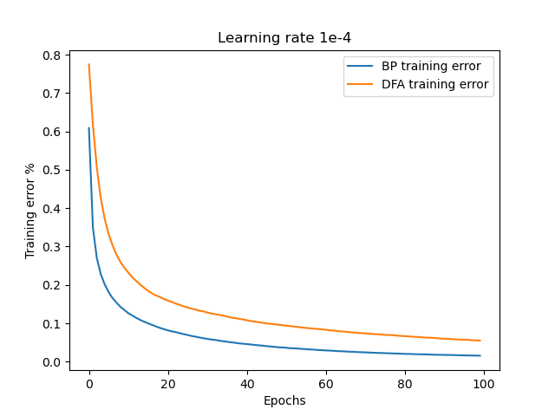
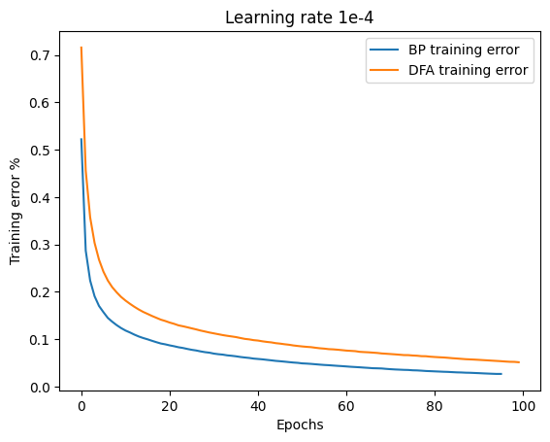
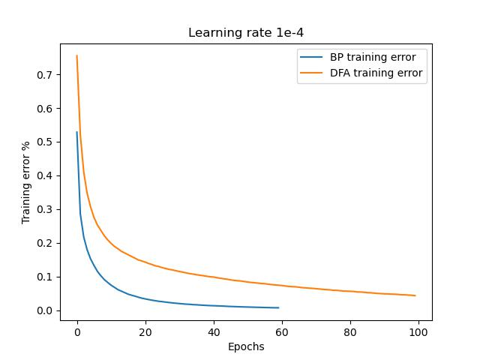
Model : ANN 1x400 tanh
Model : ANN 2x400 tanh
Model : ANN 1x800 tanh
Model : ANN 2x800 tanh

Slide 35
Conclusions
It is possible for DFA to achieve the same accuracy as Backpropagation.
DFA supports parallel computing because every layer can be trained independently.
DFA avoids calculating Iight transposition by generating a random matrix of appropriate size, which further reduces time complexity.

Slide 36
Conclusions
Optimal Implementation of DFA is tricky for large neural networks such as CNN is difficult.
DFA is coming closer to the Backpropagation result of training error but backpropagation remains ahead of DFA.

Slide 37
Thank You!

